Slide 1
Chapter 8 – Software Testing

Slide 2
Program testing
Testing is intended to show that a program does what it is intended to do and to discover program defects before it is put into use.
When you test software, you execute a program using artificial data.
You check the results of the test run for errors, anomalies or information about the program’s non-functional attributes.
Can reveal the presence of errors, NOT their absence.
Testing is part of a more general verification and validation process, which also includes static validation techniques.

Slide 3
Program testing goals
To demonstrate to the developer and the customer that the software meets its requirements.
For custom software, this means that there should be at least one test for every requirement in the requirements document. For generic software products, it means that there should be tests for all the system features, plus combinations of these features, that will be incorporated in the product release.
To discover situations in which the behavior of the software is incorrect, undesirable or does not conform to its specification.
Defect testing is concerned with rooting out undesirable system behavior such as system crashes, unwanted interactions with other systems, incorrect computations and data corruption.

Slide 4
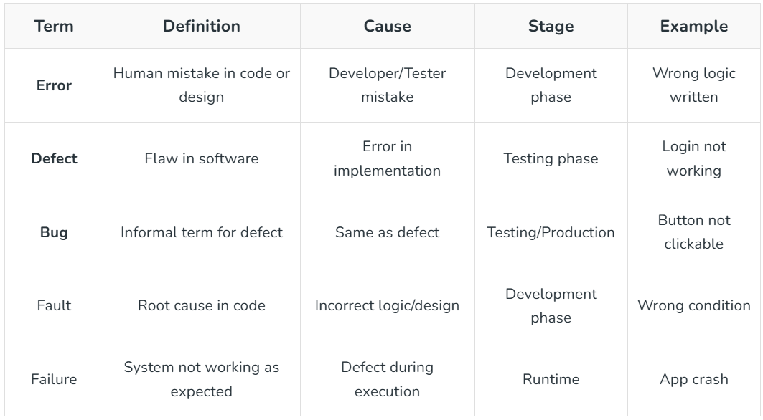
Bug vs Defect vs Error vs Fault vs Failure

Slide 5
Software Testing Strategies
Before testing starts, it’s necessary to identify and specify the requirements of the product in a quantifiable manner.
Specifying the objectives of testing in a clear and detailed manner.
For the software, identifying the user’s category and developing a profile for each user.
Developing a test plan to give value and focus on rapid-cycle testing.

Slide 6
Software Testing Strategies
Robust software is developed that is designed to test itself.
Before testing, using effective formal reviews as a filter.
Conduct formal technical reviews to evaluate the nature, quality or ability of the test strategy and test cases.
For the testing process, developing a approach for the continuous development.

Slide 7
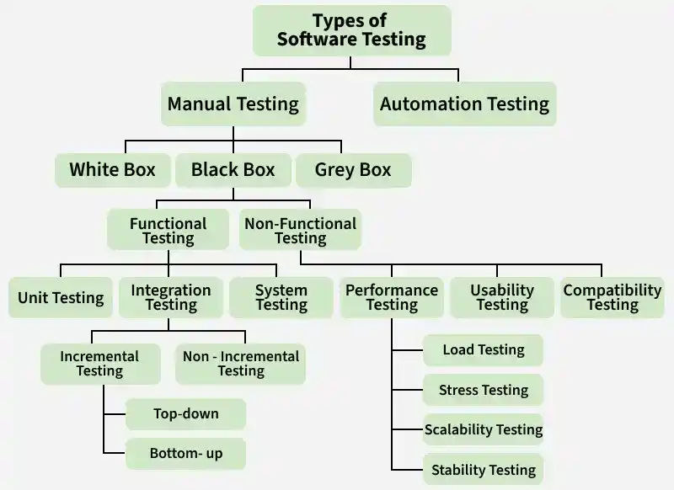

Slide 8
Overview
Software Testing is categorized into two main branches:
01
02
Manual Testing
Automation Testing
✓ Fast visual feedback
✓ Less expensive
✓ No coding required
✓ Great for unplanned changes
✓ Human intuition & judgment
✓ Simplifies test execution
✓ Improves test reliability
✓ Higher test coverage
✓ Minimizes human error
✓ Runs repetitive tasks easily
Further subdivided into: White Box • Black Box • Grey Box Testing

Slide 9
Types of Manual Testing
White Box Testing
Black Box Testing
Grey Box Testing
Tests internal code structure. Tester has full source code access. Focuses on paths, loops, and logic.
Tests functionality without knowledge of internals. Based on specs/requirements from user perspective.
Hybrid approach — partial internal knowledge. Tests both logic and user experience simultaneously.
• Thorough code testing
• Code optimization
• Early defect detection
• Integration with SDLC
• No coding skills needed
• Efficient for large systems
• User perspective testing
• Cases easily reproducible
• Clear goals for all
• User-centric approach
• Non-intrusive testing
• Improved product quality

Slide 10
Functional Testing
Under Black Box Testing
🔬 Unit Testing
🔗 Integration Testing
🖥️ System Testing
✅ UAT
Tests individual functions/methods in isolation. Done by developers early in SDLC.
Verifies that different modules work together. Includes Top-down, Bottom-up, Big-Bang.
Tests the fully integrated system against requirements before acceptance testing.
User Acceptance Testing — validates software meets business needs in real-world conditions.
🔄 Regression Testing
💨 Smoke Testing
🩺 Sanity Testing
🔁 End-to-End Testing
Ensures new changes don't break existing functionality via retesting and comparison.
Minimum tests on each build to confirm basic stability before deeper testing.
Quick check post bug-fix to confirm core functionality; stops if basics fail.
Tests entire software flow with all external interfaces and databases.

